Slide 1
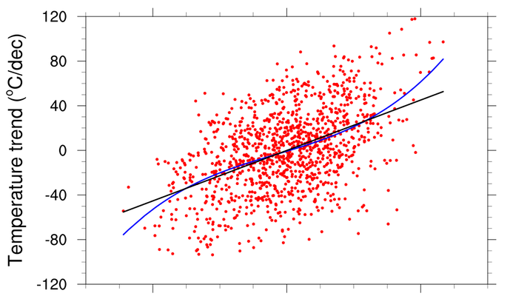

Regression

Slide 2
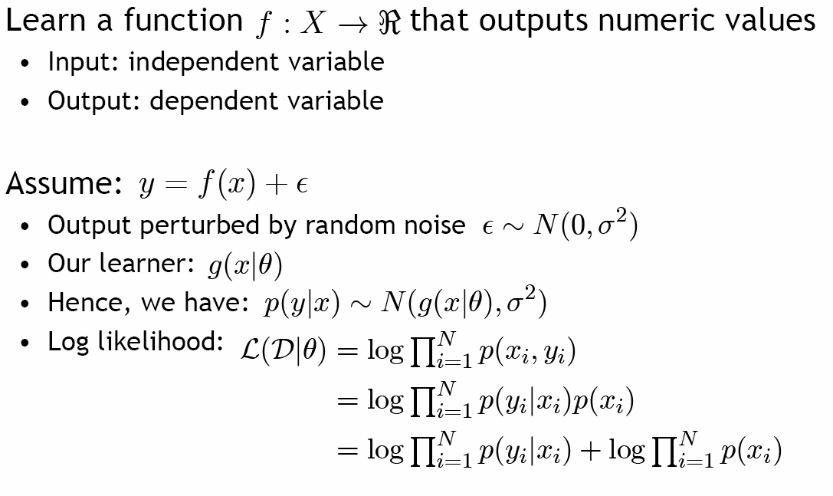






Regression
$$gθ(x)$$
$$gθ(x)$$
$$θ$$
$$θ$$
$$θ$$
$$θ$$
$$θ$$
$$θ$$
무시

Slide 3
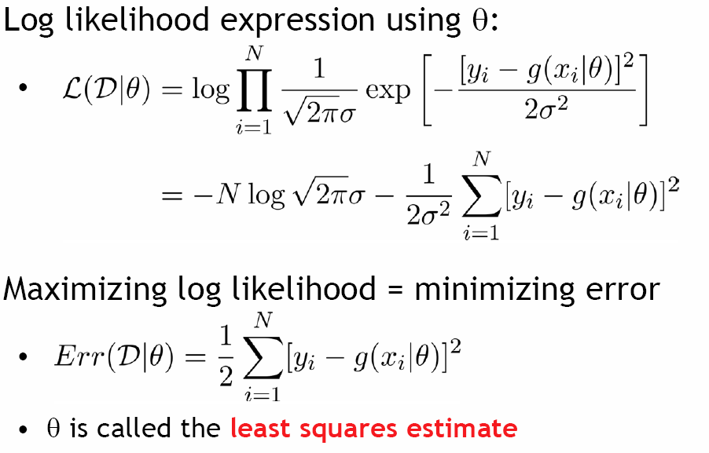
Regression

Slide 4
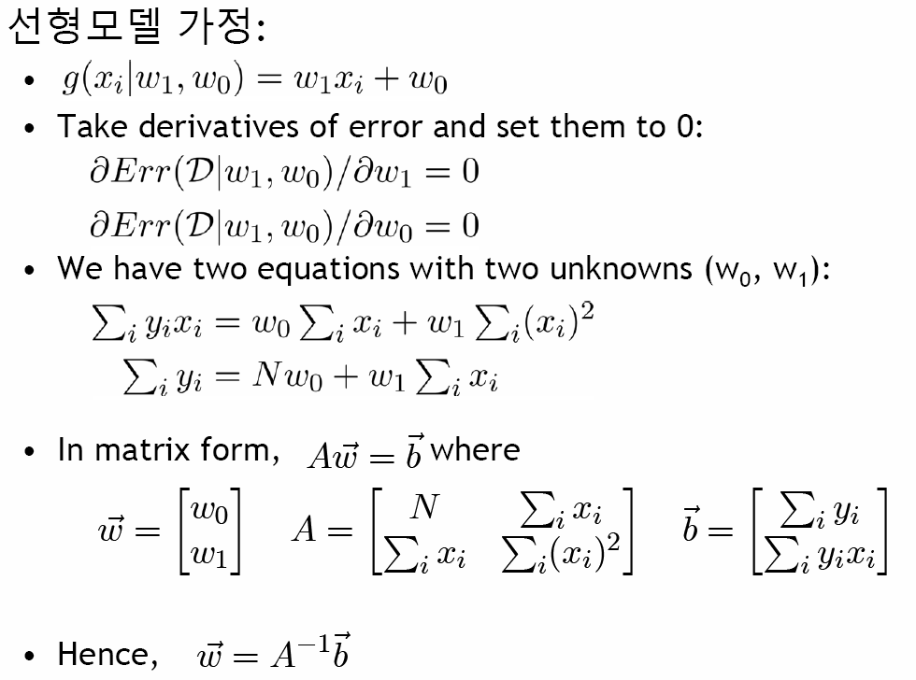
Linear Regression

Slide 5
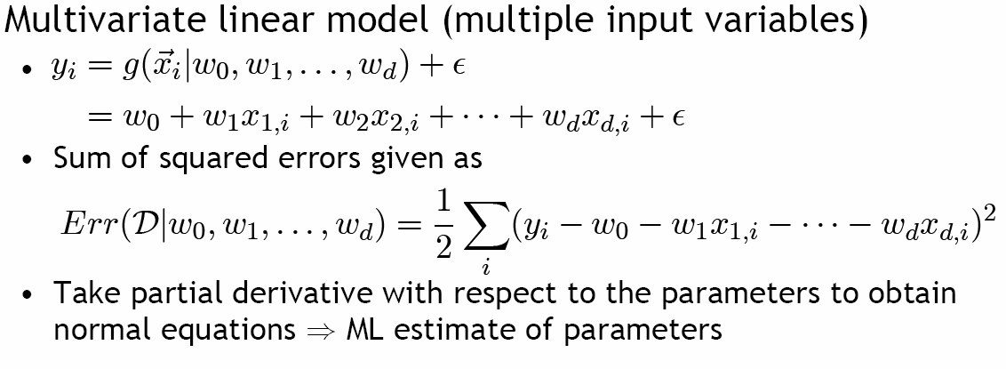
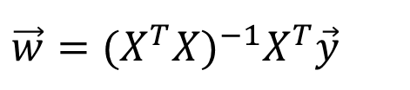
Multivariate Regression
Basis Function Expansion
(Polynomial regression)
$$\vec{w}=(X^{T}X)^{−1}X^{T}\vec{y}$$

Slide 6
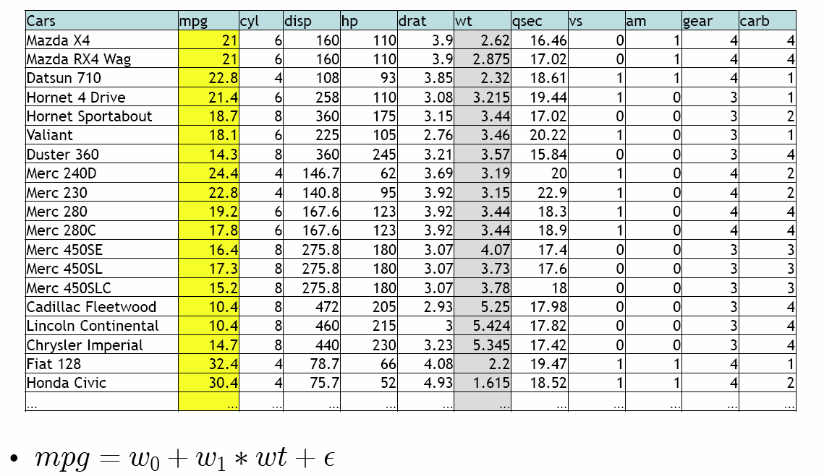
Example
http://163.180.13.121:8888/notebooks/SJ/ML/IdeaLab%20Study/Untitled.ipynb

